Slide 1
UNIT 4- HASHING
Ms. Devika Verma Assistant Professor, Dept. of Computer Eng., VIIT, Pune.

Slide 2
Introduction
According to internet data tracking services, the amount of content on the internet doubles every six months.
With traditional data structures like Arrays and Linked Lists the amount of time required to look up an element in the array is either O(log n) or O( n) based on whether the array is sorted or not.
Either case may not be desirable if we need to process a very large data set. Therefore we discuss a new technique called hashing that allows us to update and retrieve any entry in constant time O(1).
The constant time or O(1) performance means, the amount of time to perform the operation does not depend on data size n.

Slide 3
The Map Data Structure
A map is a relation between two sets.
We can define Map M as a set of pairs, where each pair is of the form (key, value), where for given a key, we can find a value using some kind of a “function” that maps keys to values.
The key for a given object can be calculated using a function called a hash function.
For example, an array is a Map where key is the index and value is the value at that index.
Hash table is a generalized idea of an array where key does not have to be an integer. We can have a name as a key, or for that matter any object as the key.
The trick is to find a hash function to compute an index so that an object can be stored at a specific location in a table such that it can easily be found.

Slide 4
Hash Table Example
Suppose we have a set of strings {“abc”, “def”, “ghi”} that we’d like to store in a table.
We assign “a” = 1, “b”=2, … etc to all alphabetical characters. We can then simply compute a number for each of the strings by using the sum of the characters as follows:
“abc” = 1 + 2 + 3=6, “def” = 4 + 5 + 6=15 , “ghi” = 7 + 8 + 9=24
If we assume that we have a table of size 5 to store these strings, we can compute the location of the string by taking the sum mod 5
So we store “abc” in 6 mod 5 = 1, “def” in 15 mod 5 = 0, and “ghi” in 24 mod 5 = 4 in locations 1, 0 and 4 as follows:

Slide 5
Problem With Hashing
One problem with hashing is that it is possible that two strings can hash into the same location. This is called a collision.
Picking a “good” hash function is key to successfully implementing a hash table. What we mean by “good” is that the function must be easy to compute and avoid collisions as much as possible.
Collisions are practically unavoidable when hashing a random subset of a large set of possible keys.
For example, if 2500 keys are hashed into a million buckets, even with a perfectly uniform random distribution, according to the birthday paradox there is a 95% chance of at least two of the keys being hashed to the same slot.
Therefore, most hash table implementations have some collision resolution strategy to handle such events.

Slide 6
Finding a “good” hash function
It is difficult to find a “perfect” hash function, that is a function that has no collisions. But we can do “better” by using hash functions as follows:
Suppose we need to store a dictionary in a hash table. A dictionary is a set of Strings and we can define a hash function as follows. Assume that S is a string of length n and S = S1S2…. Sn
H(S) = H(“S1S2…. Sn”) = S1 + p S2 + p2 S3 + ….+ pn-1 Sn
where p is a prime number. Obviously, each string will lead to a unique number
When we take the number Mod TableSize, it is still possible that we may have collisions but may be fewer collisions than when using a naïve hash function like the sum of the characters.

Slide 7
Common Hash Functions
Arithmetic Modulo
h(key) = key mod n; n = 5000
h(82461792) = 82461792 mod 5000 = 1792
Mid-Square
Involves squaring the “numeric” form of a key and extracting some of the digits from the “middle of the square”.
Assume address space is 1000
Key(4 digit int) = 2973
2973 * 2973 = 8838729
Extract “middle” digits = 387 (hash address)

Slide 8
Common Hash Functions
Folding
Requires extracting certain groupings from the key and then adding or multiplying the groupings in some fashion to form the hash address.
Key = “BISON” , Address Space = 101
Step 1 – get ASCII values of each character in the string
B(66), I(73), S(83), O(79), N(78)
Step 2 – Add “even[even index val]”
66 +83+78 = 227
Step 3 – Add “odd[odd index val]”
73+79 = 152
Step 4 – Multiply results
227 * 152 = 34504
Step 5 – Modulo results
34504 mod 101 = 63 (hash address)

Slide 9
Common Hash Functions
Radix Transformation
Convert the key to a different base and then use modulo arithmetic.
Address space is 100.
Key is 43510
Conversion: 38211
382 mod 100 = 82 (hash address)
Multiplicative Function
Involves multiplying the key by some constant less than one, the hash function will return some of the digits of the fractional part of the result.
Address space = 1000
Key (5 digit integer): 82165
Multiplier: 0.39731
82165 * 0.39731 = 32644.97615
First three digits of fractional part is hash address = 976

Slide 10
Collision Resolution Techniques
Open Addressing(Rehashing)
Linear probing (with and without chaining)
Quadratic probing
Double hashing
Closed Addressing
Separate Chaining (Open hashing)

Slide 11
Open Addressing
Cells h0(x),h1(x),h2(x),....are tried in succession where hi(x)= (hash(x)+f(i)) mod TableSize, with f(0)=0
The function f is the collision resolution strategy.
Three common techniques:
Linear probing
Quadratic probing
Double hashing

Slide 12
Linear Probing
Collisions are resolved by sequentially scanning an array (with wraparound) until an empty cell is found.
f is a linear function of i, i.e. f(i)=i
Hi(x)=(Hash(x) + f(i)) mod hSize

Slide 13
Linear Probing Example
Insert 10, 20, 30, 40, 50 in the table
Computations :
H0(10) = 10 + f(0) mod 10
= 10 + 0 mod 10 = 0
H0(20) = 20 + f(0) mod 10
= 0
H1(20) = 20 + f(1) mod 10 = 21 mod 10 =1
H0(30) = 30 +f(0) mod 10
= 0
H1(30) = (30 + 1) mod 10 =1
H2(30) = (30+2) mod 10 = 2
H3(40) = (40 + 3) mod 10 = 3
H4(50) = (50 + 4) mod 10 = 4
[0] | 10
[1] | 20
[2] | 30
[3] | 40
[4] | 50
[5]
[6]
[7]
[8]
[9]

Slide 14
Quadratic Probing
Collisions are resolved by sequentially scanning an array (with wraparound) until an empty cell is found.
f is a quadratic function of i, i.e. f(i)= i²
Hi(x)=(Hash(x) + f(i)) mod hSize
Resolves Clustering

Slide 15
Quadratic Probing Example
Insert 10, 20, 30, 40, 50 in the table
Computations :
H0(10) = 10 + f(0) mod 10
= 10 + 0 mod 10 = 0
H0(20) = 20 + f(0) mod 10
= 0
H1(20) = 20 + 1² mod 10 = 21 mod 10 =1
H0(30) = 30 + f(0) mod 10
= 0
H1(30) = (30 + 1²) mod 10 = 1
H2(30) = (30 + 2²) mod 10 = 4
H3(40) = (40 + 3²) mod 10 = 9
H4(50) = (50 + 4²) mod 10 = 6
[0] | 10
[1] | 20
[2]
[3]
[4] | 30
[5]
[6] | 50
[7]
[8]
[9] | 40

Slide 16
Double Hashing
Double hashing uses the idea of applying a second hash function to the key when a collision occurs.
f(i) = i * hash2(x)
However, hash2(x) must never evaluate to zero
A function such as hash2(x) = R- (x mod R) with R being a prime number smaller than the table size will work well.

Slide 17
Double Hashing Example
Insert 89, 18, 49, 58, 69 in the table
Hash1(key) = key mod 10
Hash2(key) = 7 – (key mod 7)
H(89) = 89 mod 10 = 9
H(18) = 18 mod 10 = 8
H(49) = 49 mod 10 = 9 → collision = 7 – (49 mod 7) = 7
H(58) = 58 mod 10 = 8 → collision
= 7 – (58 mod 7) = 5
H(69) = 69 mod 10 = 9 → collision
= 7 – (69 mod 7) = 1
[0]
[1] | 69
[2]
[3]
[4]
[5] | 58
[6]
[7] | 49
[8] | 18
[9] | 89

Slide 18
Chaining
When a collision occurs, elements with the same hash key will be chained together.
A chain is simply a linked list of all the elements with the same hash key.
The hash table slots will no longer hold a table element.
The array elements are pointers to the first nodes of the lists.
A new item is inserted to the front of the list.

Slide 19
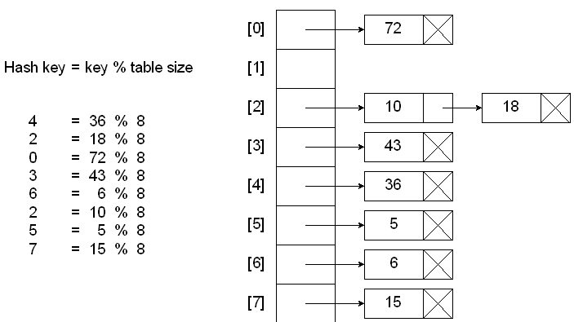
Chaining Example

Slide 20
Advantages
Better space utilization for large items
Simple collision handling : searching linked list.
Overflow: we can store more items than the hash table size.
Deletion is quick and easy : deletion from linked list

